Slide 1
Co-Learning of Renewables Forecasts and Demand Response CEI Course Project
Members:
Yiwen Wu, Xiaoxiao Jia, Yize Chen, You Chen

Slide 2
Backgrounds
High Penetration of renewables (e.g., solar, wind, hydro…)
Price-sensitive user behaviors
Stochastic pattern of renewables generation:
Can we predict it more accurately?
Participation in the renewables-integrated market:
Can we cut down the total cost by using renewables?
Challenges

Slide 3
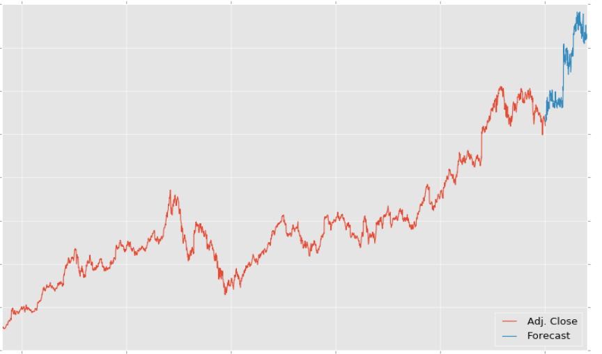
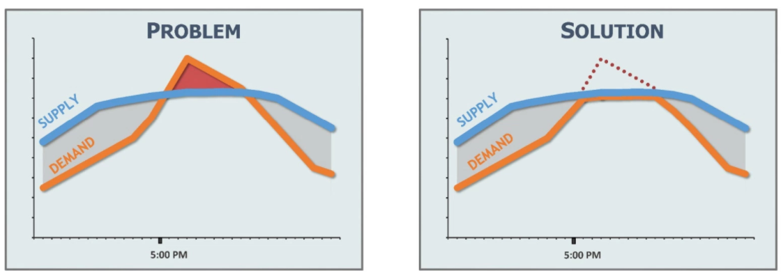
Problem Formulation
Learning to predict
Given historical data, try to predict the future energy generation
Learning to make decision
When/how to use electricity given energy/price signal

Slide 4
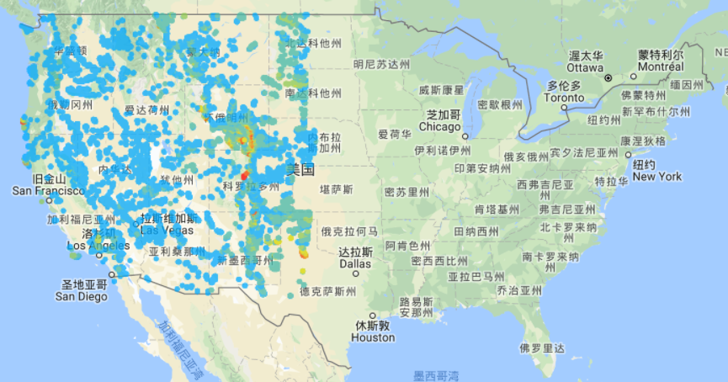
Data Description
National Renewable Energy Laboratory(NREL) Wind Integration Datasets

Slide 5
Proposed Method
1. RNN/LSTM for Time-series Forecasting
2. Reinforcement Learning(Q-learning) for user decision-making

